Slide 1
KNN Modeling Techniques (Part 2)
CUNY LaGuardia Community College

Slide 2
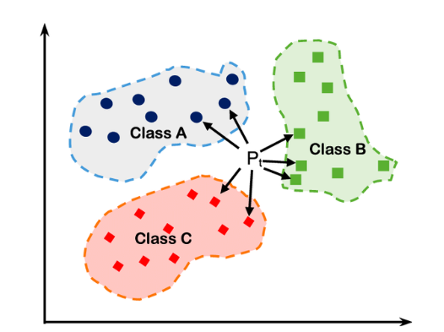
What is K-Nearest Neighbors (KNNs)?
K-Nearest Neighbors (KNN) is a simple, instance-based learning algorithm used for classification tasks. It classifies a new data point based on the K closest neighbors in feature space, assigning it the most common label among them.

Slide 3
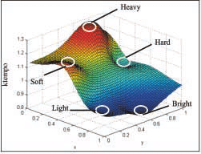
Feature Space
What is Feature Space?
Feature Space is the multi-dimensional space where each data point is represented by its features (characteristics).
Each feature is like an axis in this space (e.g., age, height, weight), and the coordinates of a point represent its specific values for these features.

Slide 4
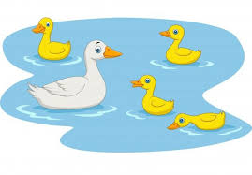
Proximity
In KNN, proximity in feature space is key. Data points that are close together share similar feature values, making them likely to belong to the same class.
"If it walks like a duck and quacks like a duck, it’s probably a duck." In feature space, a point with "duck-like" features (e.g., size, behavior, sound) will be close to other points with similar duck features. Thus, it’s likely to be classified as a duck.

Slide 5
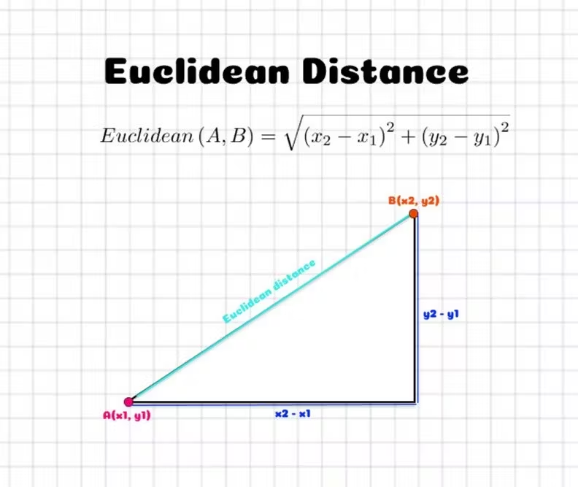
Calculating Proximity: Euclidean Distance

Slide 6

Calculating Proximity: Manhattan Distance

Slide 7
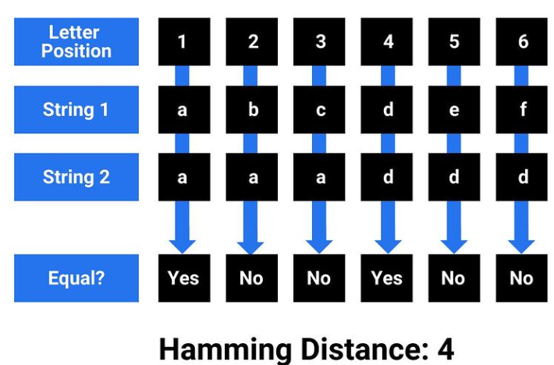
Calculating Proximity: Hamming Distance

Slide 8
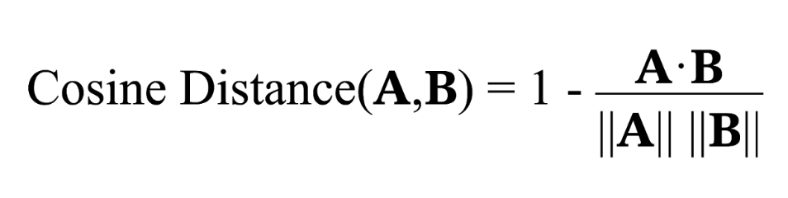
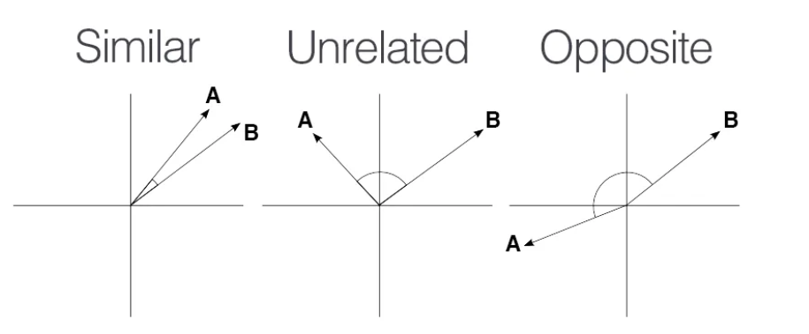
Calculating Proximity: Cosine Distance

Slide 9
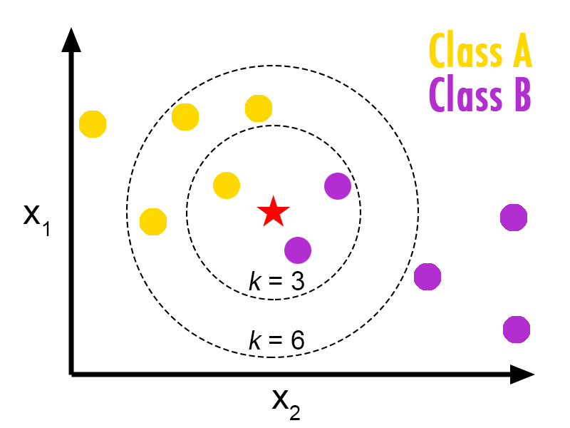
The K in KNN
How much evidence do you need to be confident that you know what something is?

Slide 10
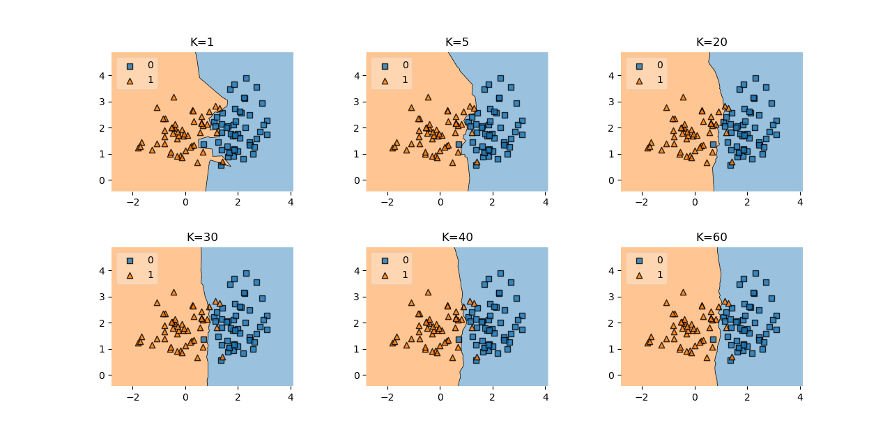
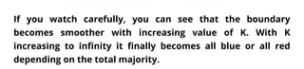
The Impact of K

Slide 11
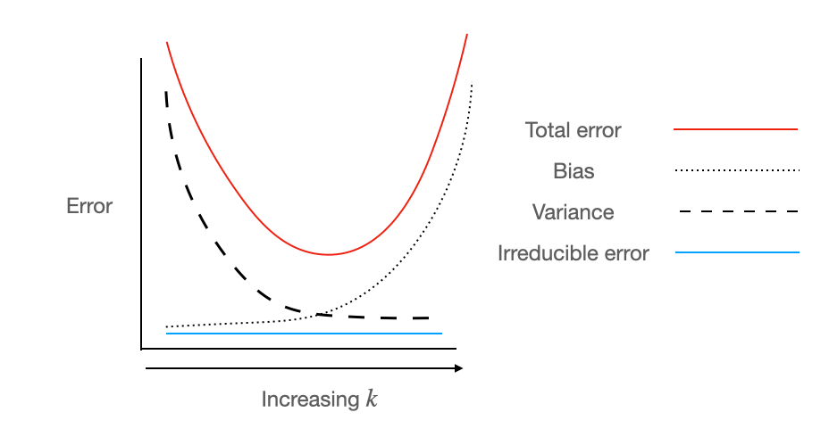
Metrics Associated with K

Slide 12
How to Choose K
Grid Search
Use a grid search algorithm to systematically test a range of K values and find the optimal one.
o
Cross-Validation
Test different K values on subsets of your data to see which provides the best accuracy and generalization on unseen data.
o
Odd vs Even K
For binary classification, an odd K value helps avoid ties when neighbors vote on the class.
o
Start with sqrt(n)
A common rule of thumb is to start with K equal to the square root of the number of data points (n).
o

Slide 13
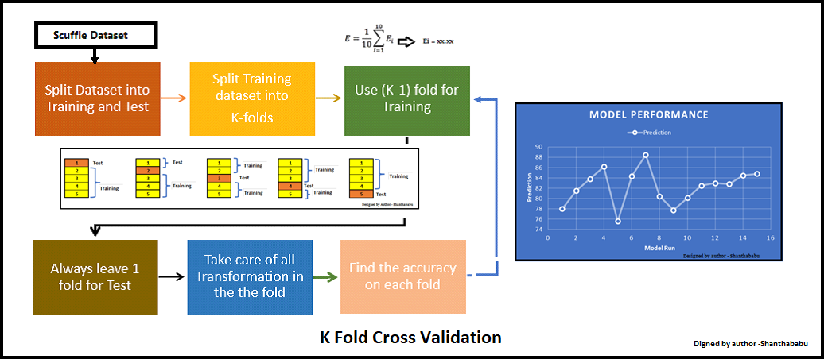
Cross Validation

Slide 14
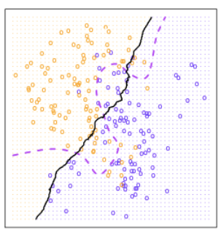
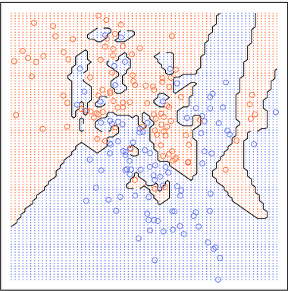
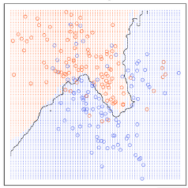
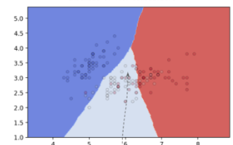
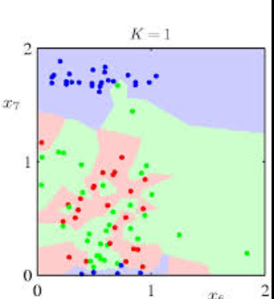
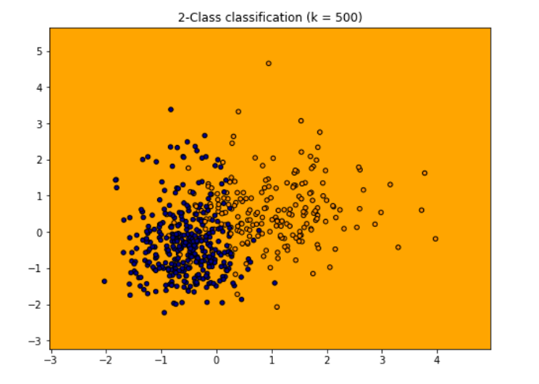
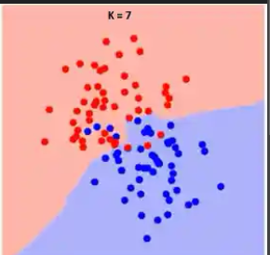
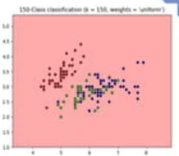
Overfit, Underfit, or Just Right?

Slide 15
KNN Model Training
Input Data
Select K and Distance Metric
Training and Prediction
Collect and preprocess the data, ensuring features are properly scaled and relevant for the classification task.
Choose K: Decide on the number of nearest neighbors (K) that will influence each prediction.
Select Distance Metric: Pick a distance measure, such as Euclidean or Manhattan, based on data characteristics.
For each data point, compute the distance between the new point and all points in the training dataset. Find the K closest data points based on the chosen distance metric. Assign the class that is most common among the K neighbors (for classification) or take the average (for regression).

Slide 16
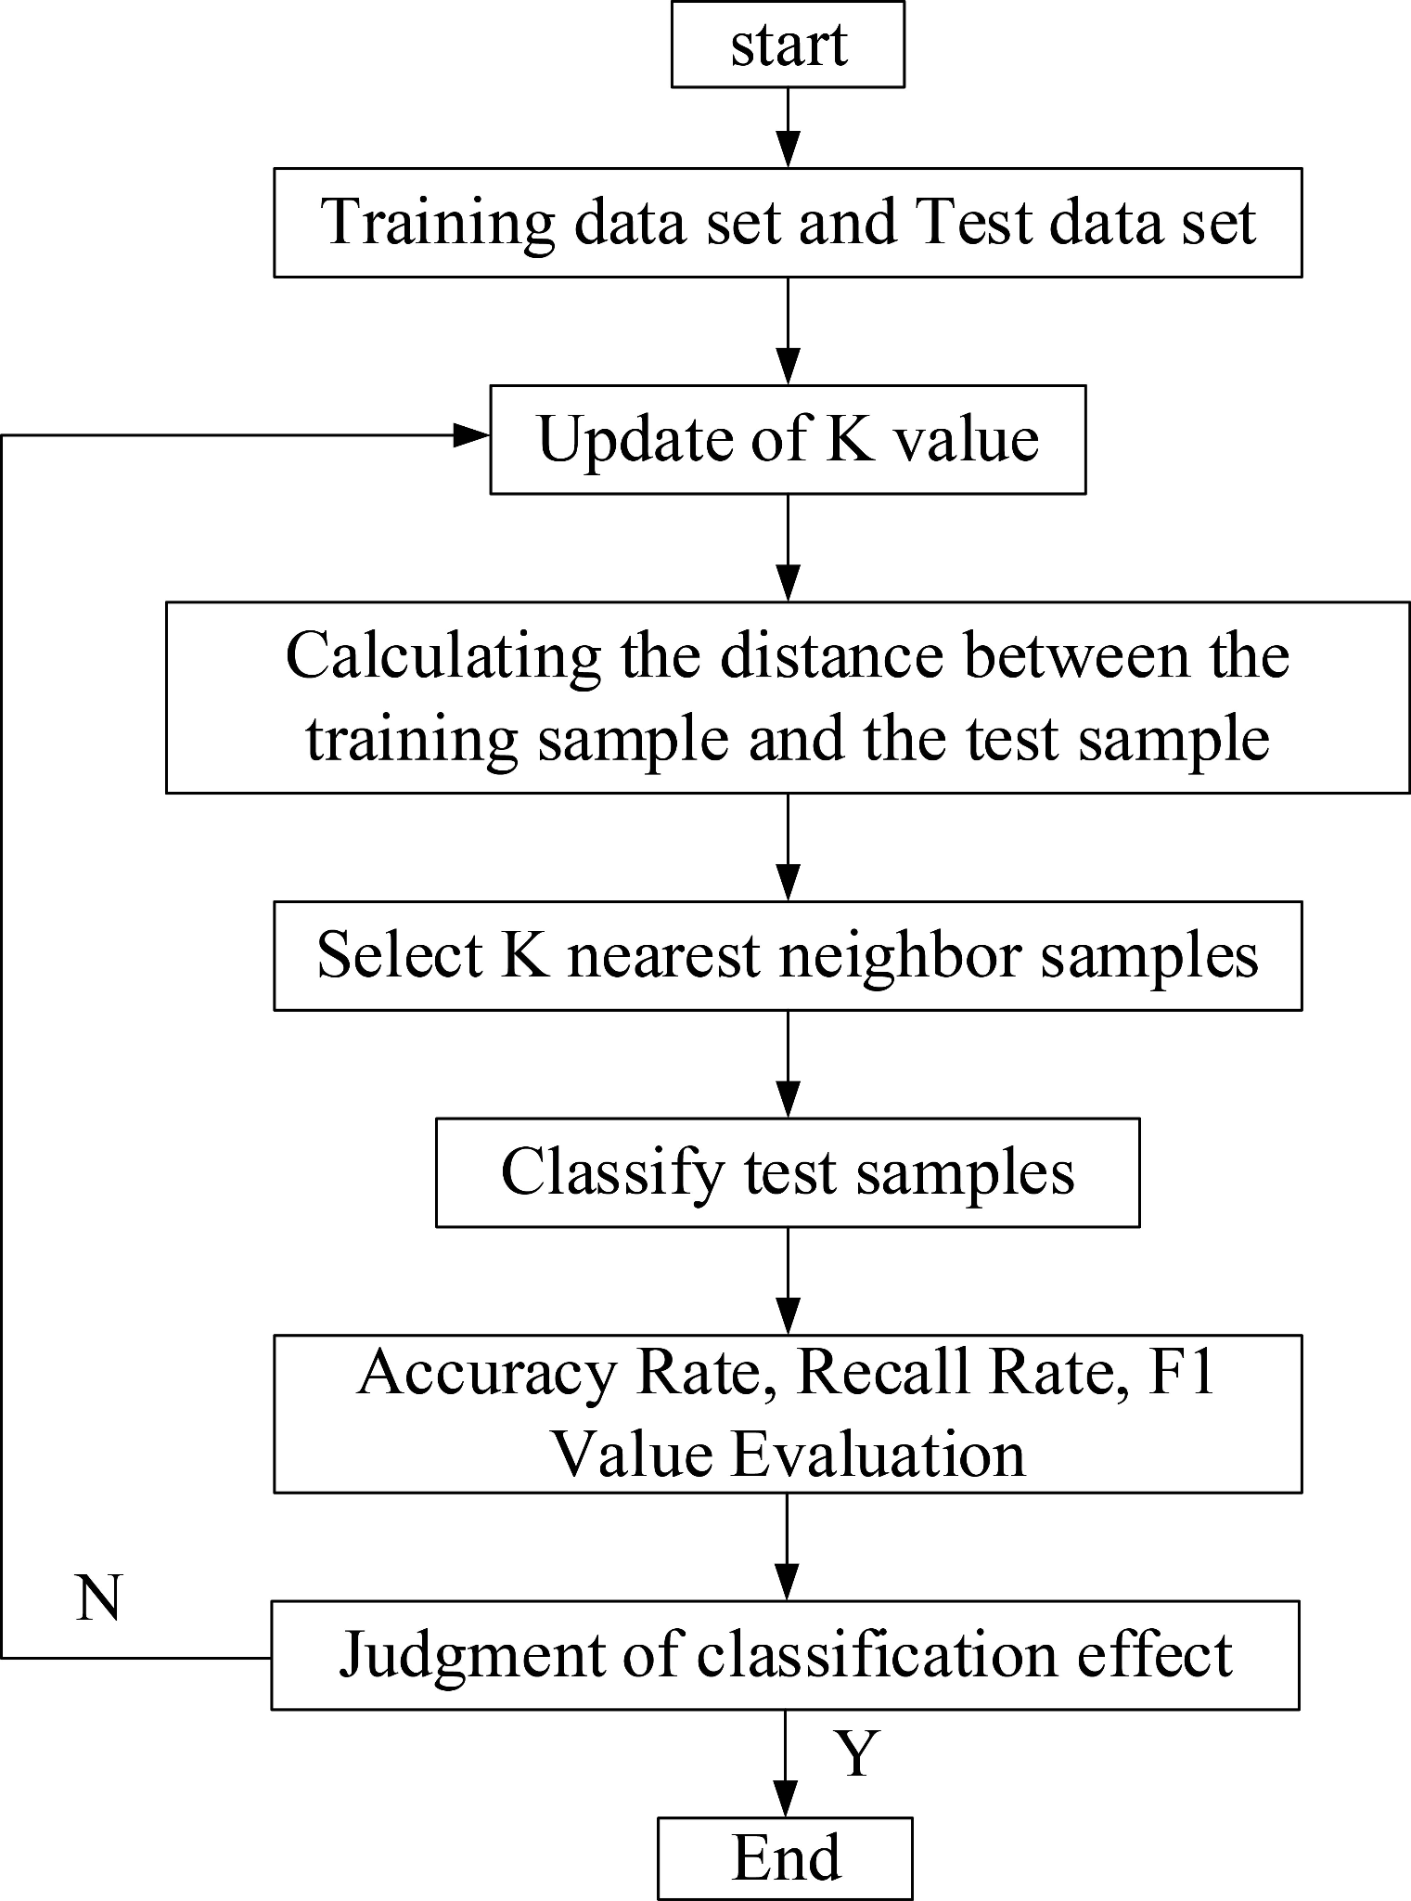
KNN Training Loop

Slide 17
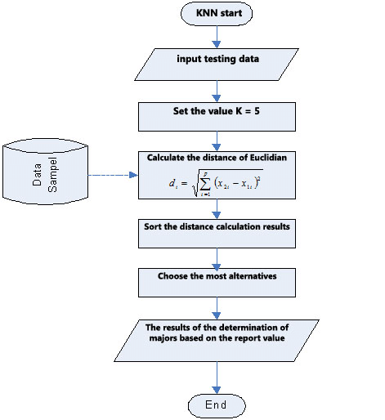
Case Study
Predicting student college majors
based on High School report card

Slide 18
Apply the Algorithm
Identify a classification problem you have encountered in real life. To apply the KNN algorithm, practice identifying the following characteristics:
Feature Space: List at least 5 features that impact this classification
Proximity Metric: Euclidian, Manhattan, Hamming, or Cosine.
Data Sample Size: How much data would you collect?
Initial K-Value: Calculate a good initial K-value based on your sample size and data context.

Slide 19
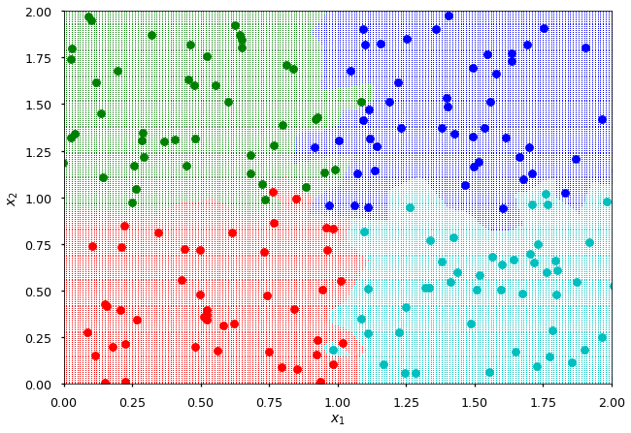
Multiclass KNN
Unlike some classification algorithms, multiclass KNN uses the exact same approach as binary KNN. For each new data point, it finds the K nearest neighbors, regardless of their class. The algorithm then assigns the new point to the most common class among these neighbors. If there’s a tie, an odd K value is often chosen to ensure a decisive classification.

Slide 20
Applications of KNN
1. Recommendation Systems
Such as Spotify, Tiktok, and Youtube’s recommendation algorithms, which often suggest things to you based on your friends’ viewing habits.
2. Image Recognition
Classifies images based on feature similarity, such as recognizing objects or handwriting by comparing to known patterns.
3. Medical Diagnosis
Used to classify patient data by matching symptoms or test results with similar past cases, aiding in disease prediction and diagnosis.

Slide 21
Advantages and Disadvantages of KNNs
Advantages
Simple and Intuitive: Easy to understand and implement.
Non-Parametric: Makes no assumptions about data distribution, making it effective for complex, real-world data.
Adaptable: Can handle non-linear boundaries and naturally clusters similar items.
Disadvantages
Computationally Expensive: Requires many calculations which is slow.
Memory Intensive: Must always have the entire dataset stored for predicting.
Affected by Imbalanced Data: Struggles with classes that are underrepresented without additional weighting or resampling techniques.

